Slide 1


Big Data Infrastructure
CS 489/698 Big Data Infrastructure (Winter 2016)
Week 10: Mutable State (1/2)
March 15, 2016
Jimmy Lin
David R. Cheriton School of Computer Science
University of Waterloo
These slides are available at http://lintool.github.io/bigdata-2016w/
This work is licensed under a Creative Commons Attribution-Noncommercial-Share Alike 3.0 United States See http://creativecommons.org/licenses/by-nc-sa/3.0/us/ for details

Slide 2
Structure of the Course
Analyzing Text
Analyzing Relational Data
Analyzing Graphs
Data Mining
“Core” framework features and algorithm design

Slide 3
The Fundamental Problem
We want to keep track of mutable state in a scalable manner
Assumptions:
State organized in terms of many “records”
State unlikely to fit on single machine, must be distributed
MapReduce won’t do!
(note: much of this material belongs in a distributed systems or databases course)

Slide 4
OLTP/OLAP Architecture
OLTP
OLAP
ETL (Extract, Transform, and Load)

Slide 5
Three Core Ideas
Partitioning (sharding)
For scalability
For latency
Replication
For robustness (availability)
For throughput
Caching
For latency

Slide 6
OLTP/OLAP Architecture
OLTP
OLAP
ETL (Extract, Transform, and Load)

Slide 7
What do RDBMSes provide?
Relational model with schemas
Powerful, flexible query language
Transactional semantics: ACID
Rich ecosystem, lots of tool support

Slide 8
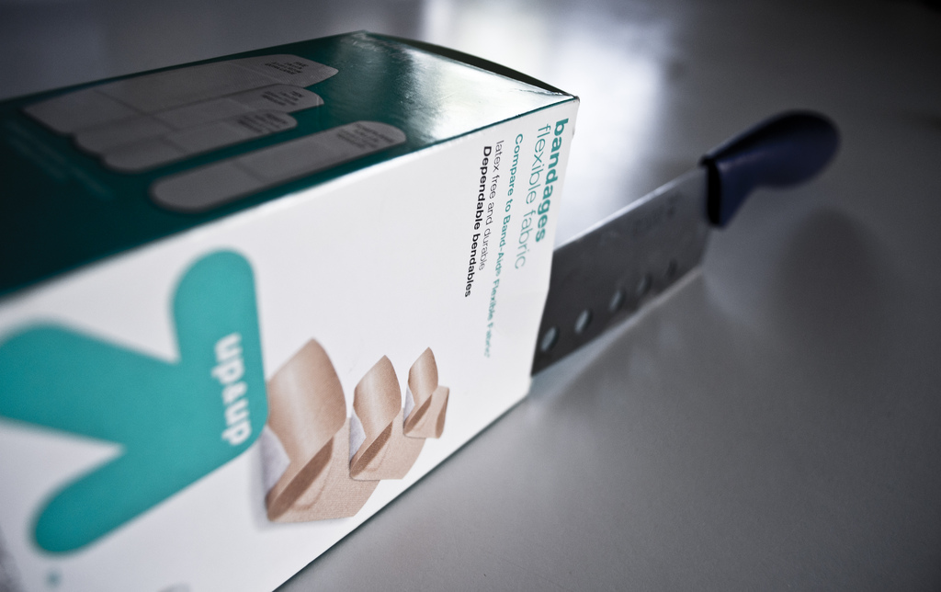
RDBMSes: Pain Points
Source: www.flickr.com/photos/spencerdahl/6075142688/

Slide 9
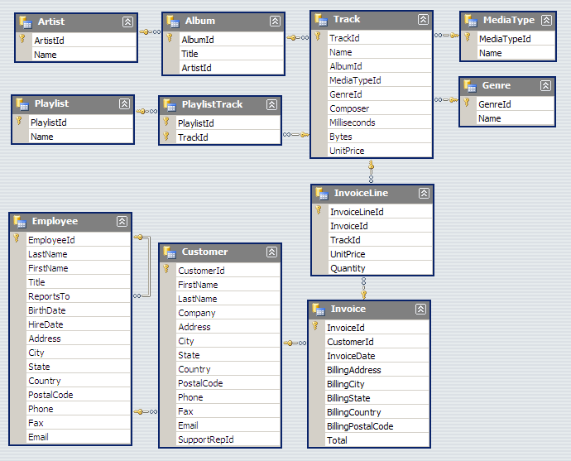
#1: Must design up front, painful to evolve
Note: Flexible design doesn’t mean no design!

Slide 10
This should really be a list…
Remember the camelSnake!
{
"token": 945842,
"feature_enabled": "super_special",
"userid": 229922,
"page": "null",
"info": { "email": "my@place.com" }
}
Is this really an integer?
Is this really null?
What keys? What values?
JSON to the Rescue!
Flexible design doesn’t mean no design!

Slide 11
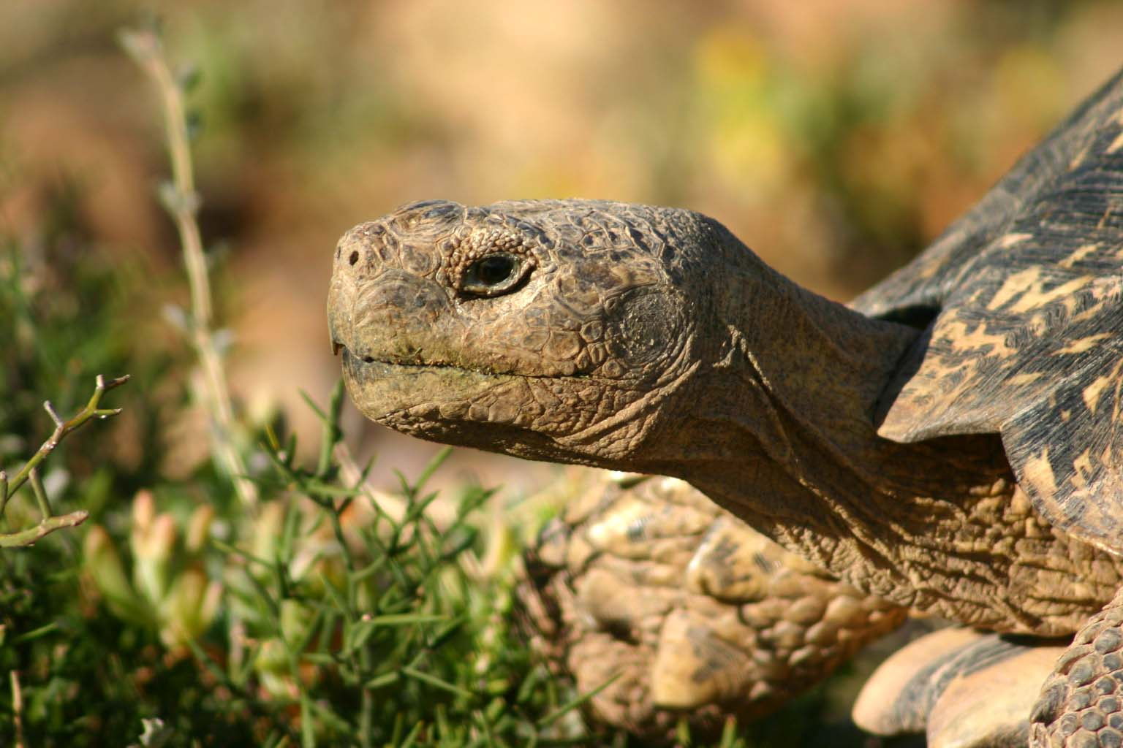
#2: Pay for ACID!
Source: Wikipedia (Tortoise)

Slide 12

#3: Cost!
Source: www.flickr.com/photos/gnusinn/3080378658/

Slide 13
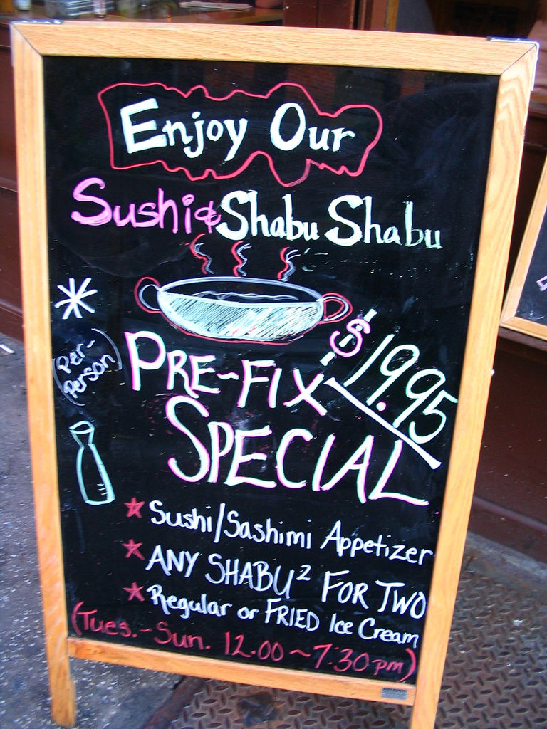
What do RDBMSes provide?
Relational model with schemas
Powerful, flexible query language
Transactional semantics: ACID
Rich ecosystem, lots of tool support
What if we want a la carte?
Source: www.flickr.com/photos/vidiot/18556565/

Slide 14
Features a la carte?
What if I’m willing to give up consistency for scalability?
What if I’m willing to give up the relational model for something more flexible?
What if I just want a cheaper solution?
Enter… NoSQL!

Slide 15
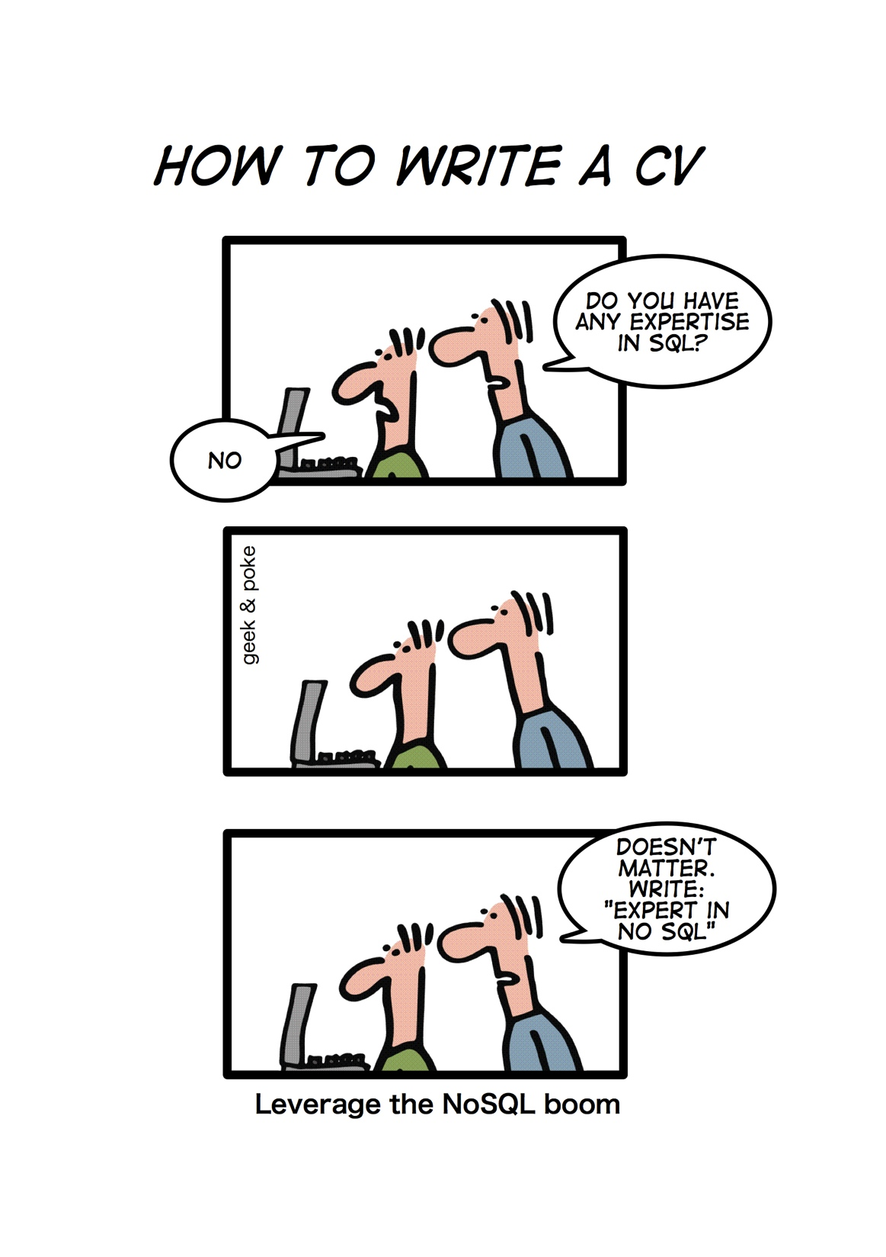
Source: geekandpoke.typepad.com/geekandpoke/2011/01/nosql.html

Slide 16
NoSQL
(Not only SQL)
Horizontally scale “simple operations”
Replicate/distribute data over many servers
Simple call interface
Weaker concurrency model than ACID
Efficient use of distributed indexes and RAM
Flexible schemas
But, don’t blindly follow the hype…
Often, (sharded) MySQL is what you really need!
Source: Cattell (2010). Scalable SQL and NoSQL Data Stores. SIGMOD Record.

Slide 17
(Major) Types of NoSQL databases
Key-value stores
Column-oriented databases
Document stores
Graph databases

Slide 18
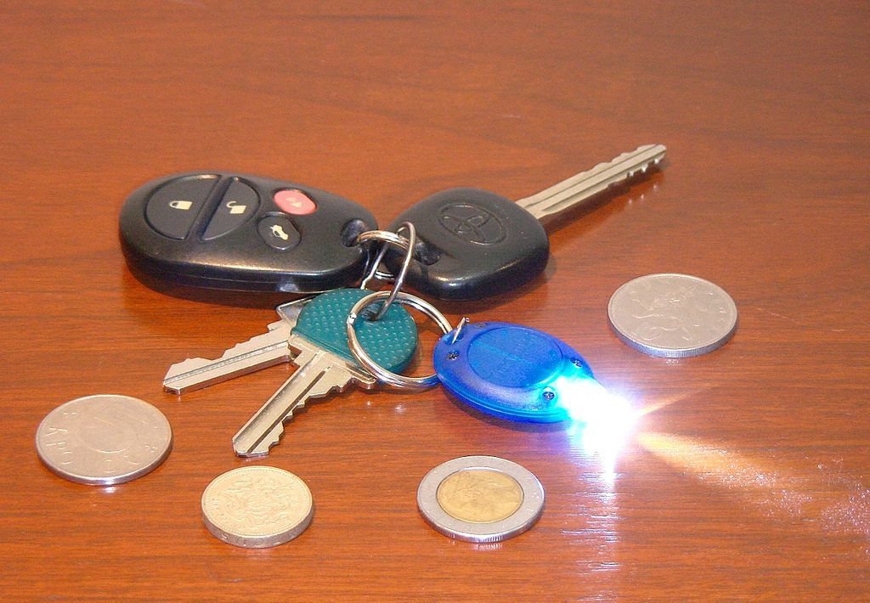
Key-Value Stores
Source: Wikipedia (Keychain)

Slide 19
Key-Value Stores: Data Model
Stores associations between keys and values
Keys are usually primitives
For example, ints, strings, raw bytes, etc.
Values can be primitive or complex: usually opaque to store
Primitives: ints, strings, etc.
Complex: JSON, HTML fragments, etc.

Slide 20
Key-Value Stores: Operations
Very simple API:
Get – fetch value associated with key
Put – set value associated with key
Optional operations:
Multi-get
Multi-put
Range queries
Consistency model:
Atomic puts (usually)
Cross-key operations: who knows?

Slide 21
Key-Value Stores: Implementation
Non-persistent:
Just a big in-memory hash table
Persistent
Wrapper around a traditional RDBMS
What if data doesn’t fit on a single machine?

Slide 22
Simple Solution: Partition!
Partition the key space across multiple machines
Let’s say, hash partitioning
For n machines, store key k at machine h(k) mod n
Okay… But:
How do we know which physical machine to contact?
How do we add a new machine to the cluster?
What happens if a machine fails?
See the problems here?

Slide 23
Clever Solution
Hash the keys
Hash the machines also!
Distributed hash tables!
(following combines ideas from several sources…)

Slide 24

h = 2^{n} – 1
h = 0

Slide 25
h = 2^{n} – 1
h = 0
Each machine holds pointers to predecessor and successor
Send request to any node, gets routed to correct one in O(n) hops
Can we do better?
Routing: Which machine holds the key?

Slide 26
h = 2^{n} – 1
h = 0
Each machine holds pointers to predecessor and successor
+ “finger table” (+2, +4, +8, …)
Send request to any node, gets routed to correct one in O(log n) hops
Routing: Which machine holds the key?

Slide 27
h = 2^{n} – 1
h = 0
Simpler Solution
Service Registry
Routing: Which machine holds the key?

Slide 28
Stoica et al. (2001). Chord: A Scalable Peer-to-peer Lookup Service for Internet Applications. SIGCOMM.
h = 2^{n} – 1
h = 0
Cf. Gossip Protoccols
How do we rebuild the predecessor, successor, finger tables?
New machine joins: What happens?

Slide 29
h = 2^{n} – 1
h = 0
Solution: Replication
N = 3, replicate +1, –1
Covered!
Covered!
Machine fails: What happens?

Slide 30
Another Refinement: Virtual Nodes
Don’t directly hash servers
Create a large number of virtual nodes, map to physical servers
Better load redistribution in event of machine failure
When new server joins, evenly shed load from other servers

Slide 31

Bigtable
Source: Wikipedia (Table)

Slide 32
Bigtable Applications
Gmail
Google’s web crawl
Google Earth
Google Analytics
Data source and data sink for MapReduce
HBase is the open-source implementation…

Slide 33
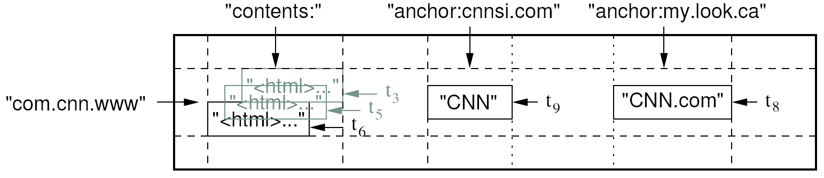
Data Model
A table in Bigtable is a sparse, distributed, persistent multidimensional sorted map
Map indexed by a row key, column key, and a timestamp
(row:string, column:string, time:int64) → uninterpreted byte array
Supports lookups, inserts, deletes
Single row transactions only
Image Source: Chang et al., OSDI 2006

Slide 34
Rows and Columns
Rows maintained in sorted lexicographic order
Applications can exploit this property for efficient row scans
Row ranges dynamically partitioned into tablets
Columns grouped into column families
Column key = family:qualifier
Column families provide locality hints
Unbounded number of columns
At the end of the day, it’s all key-value pairs!

Slide 35
Key-Values
row, column family, column qualifier, timestamp
value

Slide 36
Okay, so how do we build it?
In Memory
On Disk
Mutability Easy
Mutability Hard
Small
Big

Slide 37
Bigtable Building Blocks
HBase
HDFS
GFS
Chubby
SSTable
Zookeeper
HFile

Slide 38
SSTable
HFile
Basic building block of Bigtable
Persistent, ordered immutable map from keys to values
Stored in GFS
Sequence of blocks on disk plus an index for block lookup
Can be completely mapped into memory
Supported operations:
Look up value associated with key
Iterate key/value pairs within a key range
We get replication for free!
64K block
64K block
64K block
SSTable
Index
Source: Graphic from slides by Erik Paulson

Slide 39
Tablet
Region
Dynamically partitioned range of rows
Built from multiple SSTables
Tablet
Start:aardvark
End:apple
64K block
64K block
64K block
SSTable
64K block
64K block
64K block
SSTable
Index
Index
Source: Graphic from slides by Erik Paulson

Slide 40
Table
Multiple tablets make up the table
SSTables can be shared
Tablet
Tablet
aardvark
apple
apple_two_E
boat
SSTable
SSTable
SSTable
SSTable
Source: Graphic from slides by Erik Paulson

Slide 41
How do I get mutability?
Easy, keep everything in memory!
What happens when I run out of memory?

Slide 42
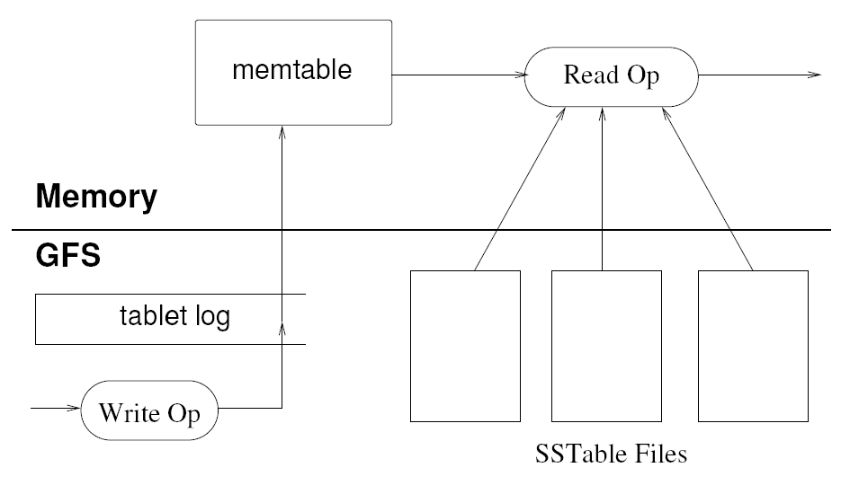
Tablet Serving
MemStore
“Log Structured Merge Trees”
Image Source: Chang et al., OSDI 2006

Slide 43
Architecture
Client library
Single master server
Tablet servers
HMaster
RegionServers

Slide 44
Bigtable Master
Assigns tablets to tablet servers
Detects addition and expiration of tablet servers
Balances tablet server load
Handles garbage collection
Handles schema changes

Slide 45
Bigtable Tablet Servers
Each tablet server manages a set of tablets
Typically between ten to a thousand tablets
Each 100-200 MB by default
Handles read and write requests to the tablets
Splits tablets that have grown too large

Slide 46
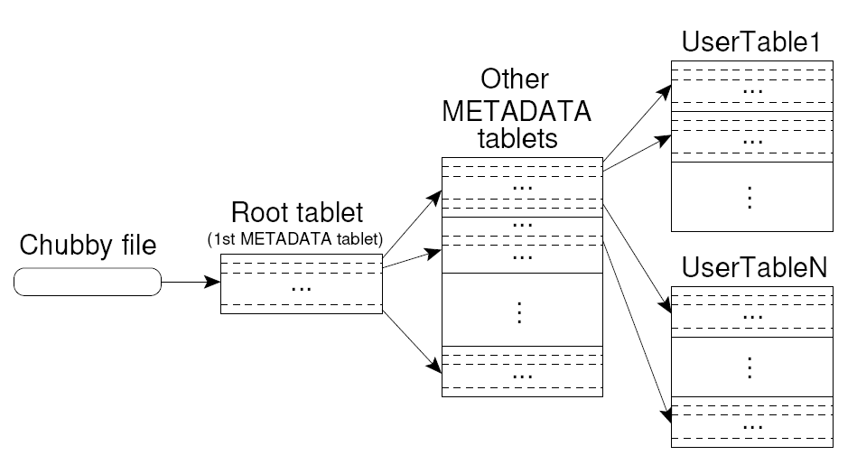
Tablet Location
Upon discovery, clients cache tablet locations
Image Source: Chang et al., OSDI 2006

Slide 47
Tablet Assignment
Master keeps track of:
Set of live tablet servers
Assignment of tablets to tablet servers
Unassigned tablets
Each tablet is assigned to one tablet server at a time
Tablet server maintains an exclusive lock on a file in Chubby
Master monitors tablet servers and handles assignment
Changes to tablet structure
Table creation/deletion (master initiated)
Tablet merging (master initiated)
Tablet splitting (tablet server initiated)

Slide 48
Table
Multiple tablets make up the table
SSTables can be shared
Tablet
Tablet
aardvark
apple
apple_two_E
boat
SSTable
SSTable
SSTable
SSTable
Source: Graphic from slides by Erik Paulson

Slide 49
Tablet Serving
“Log Structured Merge Trees”
Image Source: Chang et al., OSDI 2006

Slide 50
Compactions
Minor compaction
Converts the memtable into an SSTable
Reduces memory usage and log traffic on restart
Merging compaction
Reads the contents of a few SSTables and the memtable, and writes out a new SSTable
Reduces number of SSTables
Major compaction
Merging compaction that results in only one SSTable
No deletion records, only live data

Slide 51
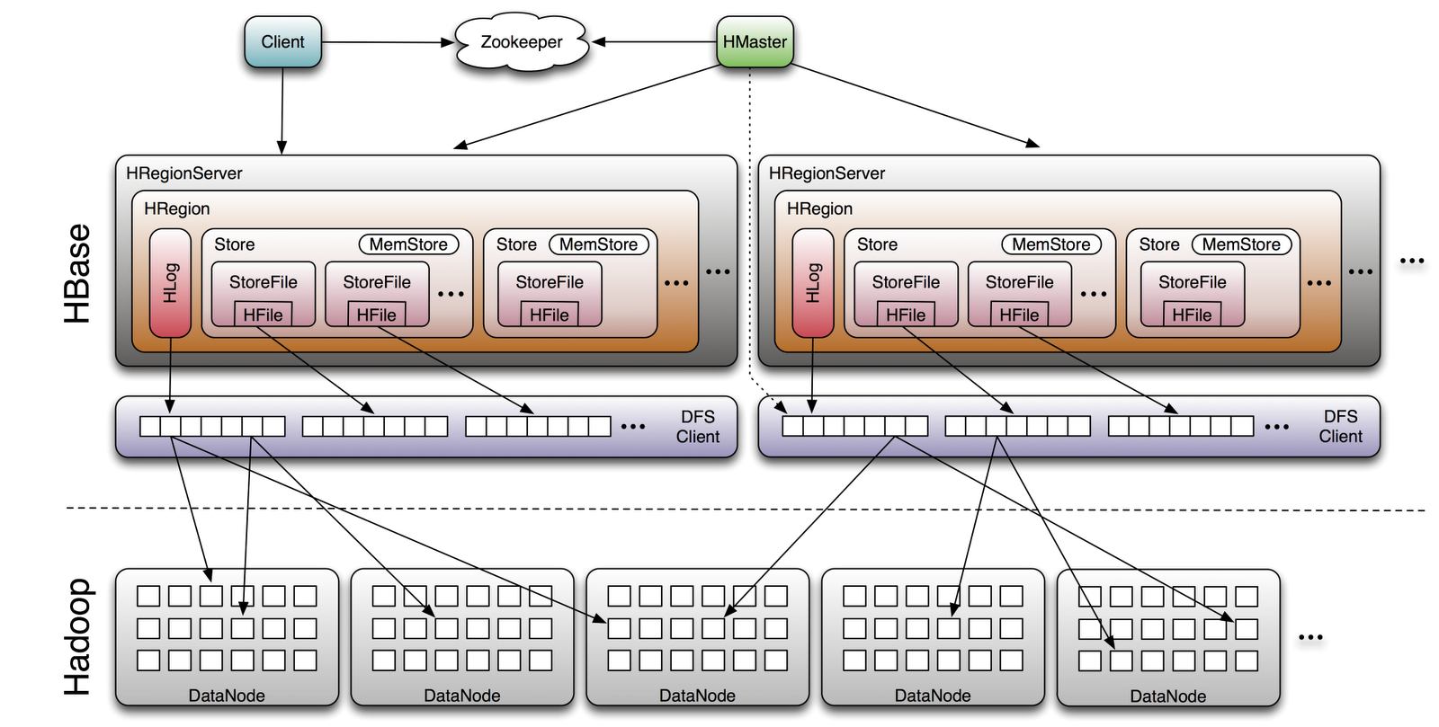
HBase
Image Source: http://www.larsgeorge.com/2009/10/hbase-architecture-101-storage.html

Slide 52
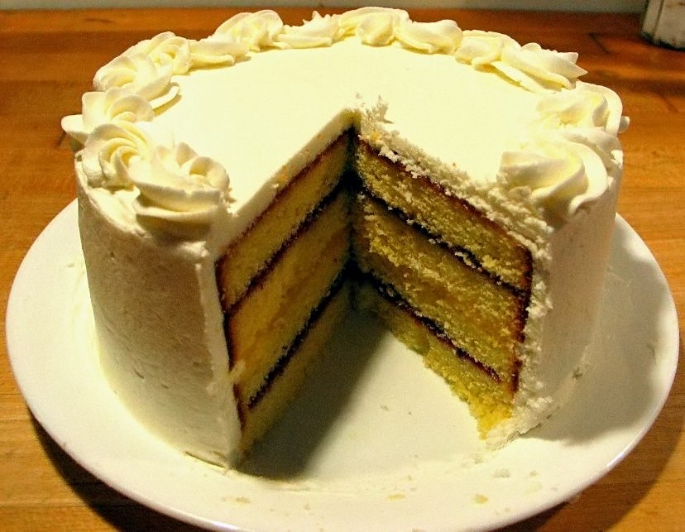
Source: Wikipedia (Cake)

Slide 53

Questions?
Source: Wikipedia (Japanese rock garden)

